Slide 1

Blue Brain
POLOJU SHIVA SINDHU
18AG1A0546

Slide 2
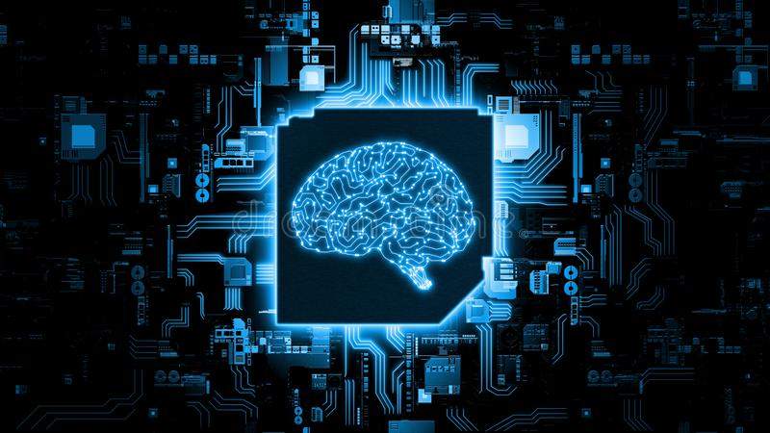

Slide 3

CONTENTS
INTRODUCTION
WHAT IS BLUE BRAIN
WHAT IS VIRTUAL BRAIN
NEED OF VIRTUAL BRAIN
FUNCTIONS OF BRAIN
BRAIN STIMULATION
BLUE BRAIN PROJECTS
HARDWARE AND SOFTWARE REQUIREMENTS
ADVANTAGES AND DISADVANTAGES
CONLUSION

Slide 4
Introduction
Human brain, the most valuable creation of
God. The man is called intelligent because of the brain. But we loss the knowledge of a brain when the body is destroyed after the death .
“BLUE BRAIN”- The name of the world’s first virtual brain. That means a machine that
can function as human brain.
Is it really possible to create a human brain?

Slide 5

What is Blue Brain?
YES", The IBM is now developing a virtual brain known as the BLUE BRAIN.
It would be the worlds first virtual brain.
Within 30 years, we will be able to scan ourselves into the computers.

Slide 6
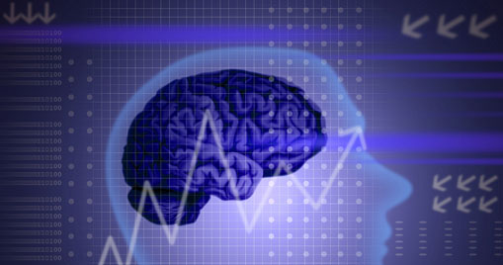
What is virtual Brain?
A machine that can function as brain
It can take decision.
It can think.
It can response.
It can keep things in memory.

Slide 7
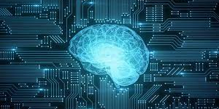
Need of virtual Brain?
To upload contents of the natural brain into it .
To keep the intelligence , knowledge and skill of any person for ever .
To remember things without any effort .

Slide 8
Function of Brain
Receiving input such as sound ,image, etc
Interpretation of the received input by the brain by defining states of neurons in the brain
Receiving of electric responses from the brain to perform any actions

Slide 9
Brain simulation
Natural Brain
Simulated Brain
Input through the natural neurons
Interpretation by different states of the neurons in the brain.
Output through neurons
Processing through arithmetic and logical calculations
Memory through permanent states of neurons
Input through the silicon chip or artificial neurons
Interpretation by a set of bits in the set of register
Output through the silicon chip.
Processing through arithmetic and logical calculation and artificial intelligence

Slide 10
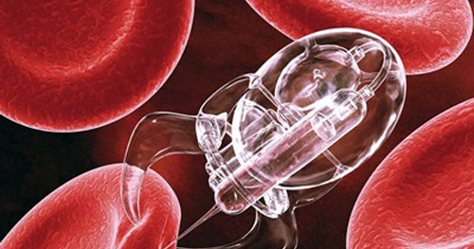
Nanobots
The uploading is possible by the use of small robots known as the nanobots.
These robots are small enough to travel through out our circulatory system.
Traveling into the spine and brain, they will be able to monitor the activity and structure of our central nervous system.
They will be able to provide an interface with computer while we still reside in our biological form .

Slide 11
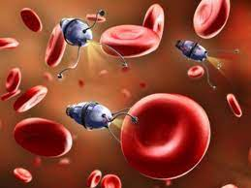
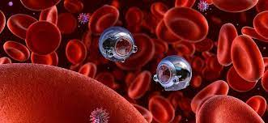

Slide 12

Example of Blue Brain
A very good example of utilization of blue brain is the case "short term memory".
In some movies we might have noticed that a person might be having short term memories.
A another situation is that when a person gets older, then he starts forgetting or takes a bit more time to recognize to a person.
For the above reason we need a blue brain. It is a simple chip that can be installed into the human brain for which the short term memory and volatile memory at the old age can be avoided.

Slide 13

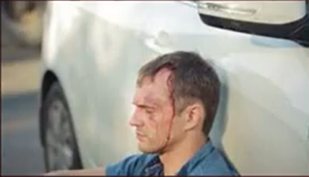
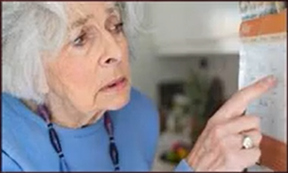
Short Term Memory Loss
Accident patient
Increasing Age

Slide 14
Blue Brain project objectives
The project will search for insights into how human beings think and remember.
Scientists think that blue brain could also help to cure the Parkinson's disease.
The brain circuitry is in a complex state of flux, the brain rewiring itself every moment of its existence. If the scientists can crack open the secret of how and why the brain does it, the knowledge could lead to new breed of supercomputers.

Slide 15
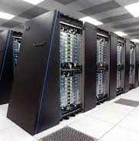
IBM developing the “Blue brain” .
IBM, in partnership with scientists at Switzerland’s Ecole Polytechnique Federal De Lausanne’s(EPFL) Brain and Mind Institute will begin simulating the brain’s biological systems.

Slide 16
Hardware and software Requirements
A Supercomputer.
Memory with a very large storing capacity.
Processor with a very high processing power.
A very wide network.
A program to convert the electric impulses from the brain to input signal, which is to be received by the computer and vice versa.
very powerful Nanobots to act as the interface between the natural brain and the computer.

Slide 17
Advantages
Remembering things without any effort.
Making decision without the presence of a person.
Using intelligence of a person after the death .
Understanding the activities of animals .
Allowing the deaf to hear via direct nerve stimulation.

Slide 18
Disadvantages
We become dependent upon the computer .
Others may use technical knowledge against us.
Another fear is found with respect to human cloning.
A very costly procedure of regaining the memory back.

Slide 19
Conclusions
We will be able to transfer ourselves into computers at some point.
It will bring both benefits and harm to human society .
Eventually aim of applying terrific computer power to the simulation of an entire brain.
Very soon this technology will be highly accepted whole over the world.

Slide 20

THANK YOU!

